Slide 1

Analysis

Slide 2
INTRODUCTION
Myntra is an Indian fashion e-commerce company headquartered in Bengaluru, Karnataka, India. The company was founded in 2007-2008 to sell personalized gift items. In May 2014, Myntra.com was acquired by Flipkart.
In May 2022, Myntra launched an express delivery service on its app to offer a one-of-a-kind experience on its fashion and beauty platform. This service allows shoppers to receive their orders for products marked with ‘M-express tag’ on the listing page within 24–48 hours of purchase
.

Slide 3

BUSINESS MODEL
Online Marketplace
Myntra operates as an online marketplace for fashion and lifestyle products. It partners with over 6,000 brands, including well-known names like Levi's, Nike, and Mango
Revenue Generation
The primary source of revenue for Myntra comes from transaction fees paid by third-party vendors who sell their products on the platform. Additionally, Myntra generates income through logistics, advertising, and consulting services
Acquisition by Flipkart:
In 2014, Myntra was acquired by Flipkart, which has helped it tap into additional resources and expand its market presence

Slide 4
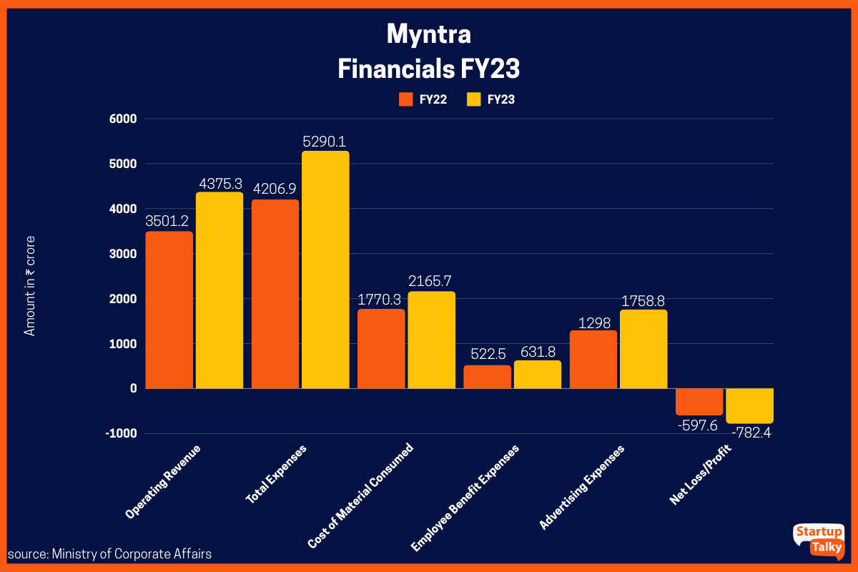
MARKET POSITION AND GROWTH
Myntra’s GMV growth has been constantly outpacing the market, touching 2X of the online fashion market growth in the festive season Integral to this growth has been the 33% surge in Monthly Active Users (MAU), rising from 45 million in 2021 to an impressive ~60 million by the end of 2023 Myntra remains confident about future growth prospects while doubling down on its key pillars for expansion

Slide 5
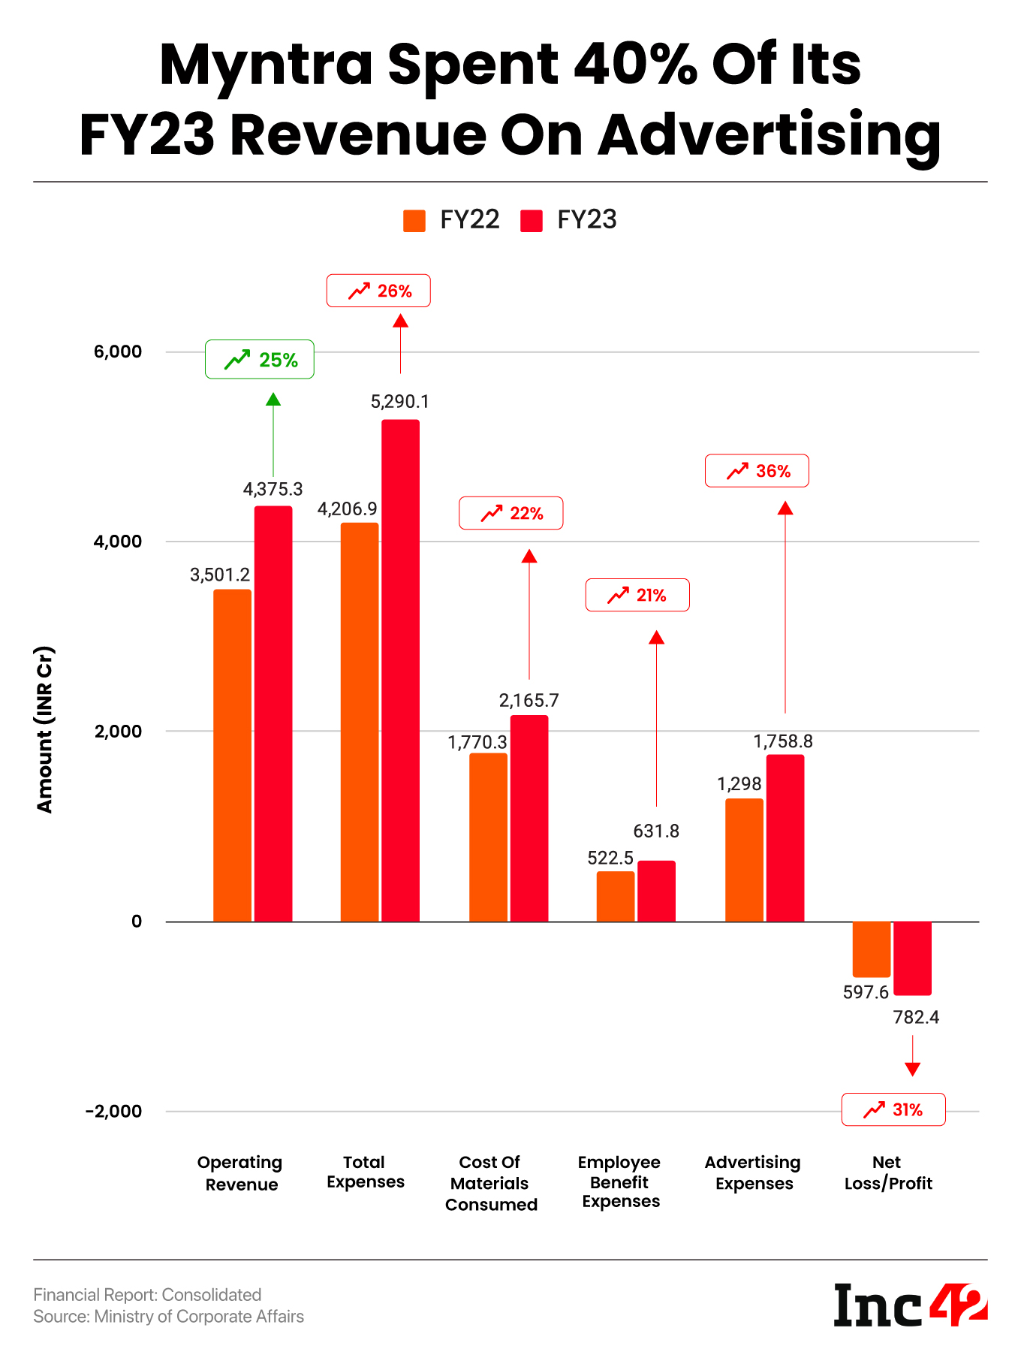



MYNTRA REVENUE MODEL
YEAR 2022 - 2023
Operating Revenue
Myntra saw a 25% increase in revenue, with their operating revenue rising from ₹3,501 crore in FY22 to ₹4,375 crore in FY23.
Total expenses
Myntra's total expenses increased by 26% from Rs 4,207 crore in
2022 to Rs 5,290 crore in 2023.
Product Advertising
In the financial year 2022-2023, Myntra significantly increased its advertising and promotional expenses. They spent ₹1,758 crore on advertising and promotions

Slide 6






MEMBERSHIP AND MARKET PLACE REVENUE
Myntra Insider Membership
No Membership Fee: There is no fee to join the Myntra Insider program.
Super Coins: Members earn Super Coins for every purchase made on the Myntra app or website. The number of Super Coins earned depends on the membership tier:
Select Tier: 1 Super Coin for every ₹100 spent.
Elite Tier: 2 Super Coins for every ₹100 spent.
Icon Tier: 3 Super Coins for every ₹100 spent.
Market Place Revenue
Transaction fees
Logistics services
Advertisement services
Consultancy services
Selling products under its own label

Slide 7








TECHNOLOGY UTILIZATION
Augmented Reality (AR) and Virtual Reality (VR)
Data Analytics and Machine Learning
Personalization
Supply Chain Optimization
Innovation Lab
Social Commerce
Customer Support

Slide 8


DATA ANALYTICS AND PERSONALIZATION
Customer Insights
By analyzing customer data, Myntra can understand customer preferences, buying patterns, and trends. This information is used to tailor marketing strategies and improve customer engagement.
Personalization
Myntra uses AI-driven algorithms to offer personalized recommendations based on user behavior, preferences, and purchase history. This helps in enhancing the shopping experience and increasing customer satisfaction.
.

Slide 9
CUSTOMER REVIEW ANALYSIS
Positive Feedback
Product Variety
Wide Selection: Customers appreciate the extensive range of products, including clothing, footwear, accessories, and beauty items. Many reviews highlight the availability of both local and international brands.
Exclusive Collections: Myntra’s collaboration with designers and exclusive collections receive positive mentions.
User Experience
User-Friendly Interface: The app and website are often praised for their intuitive design and ease of use.
Personalized Recommendations: Many users find the personalized product recommendations helpful in discovering new items that match their preferences.
Customer Service
Responsive Support: Positive reviews often mention the helpfulness and responsiveness of Myntra’s customer service team in resolving issues and answering queries.

Slide 10
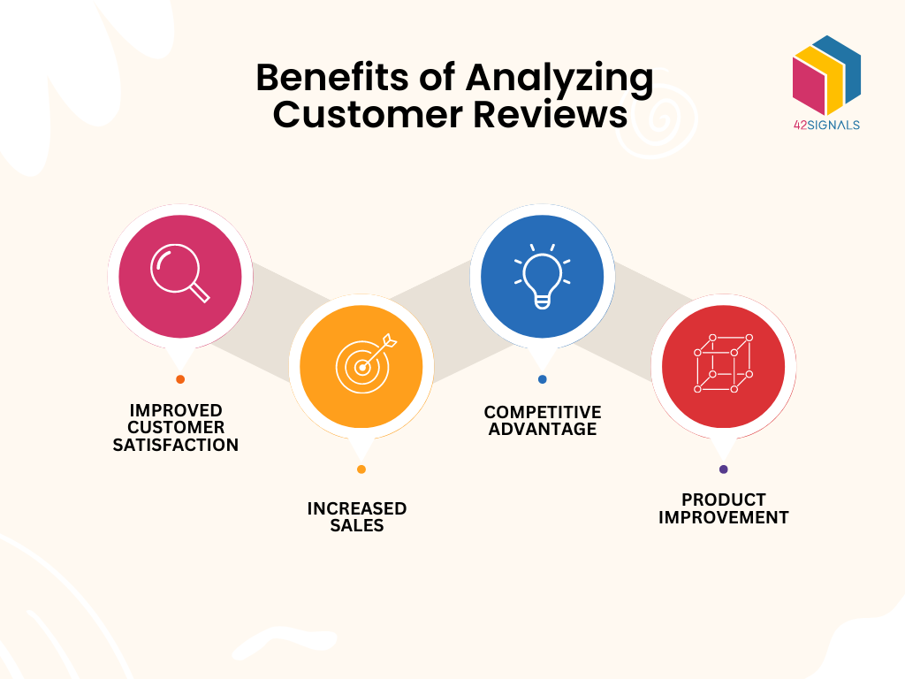
Negative Feedback
Delivery and Logistics:
Delays: Some customers report delays in receiving their orders, especially during peak sale periods.
Packaging Issues: There are occasional complaints about
inadequate packaging, leading to damaged products.
Product Quality:
Inconsistent Quality: Some customers express concerns
about the quality of certain products not meeting their expectations.
Issues with counterfeit or low-quality items occasionally arise.
Return and Refund Process:
Complicated Returns: The return process is sometimes
described as cumbersome and time-consuming, with delays in
processing refunds or exchanges.
2.Customer Support: While generally positive, some reviews mention difficulties in getting timely resolutions for return and refund-related issues.

Slide 11

Areas for Improvement:
Streamline Delivery: Enhancing logistics to reduce delivery times and ensure timely shipping, especially during high-demand periods.
Quality Control: Implementing stricter quality checks to ensure product authenticity and maintain consistent quality standards.
Improve Returns Process: Simplifying the return and refund process to make it more user-friendly and efficient.
Enhanced Customer Engagement: Fostering better communication with customers regarding order status and resolving complaints more swiftly.

Slide 12





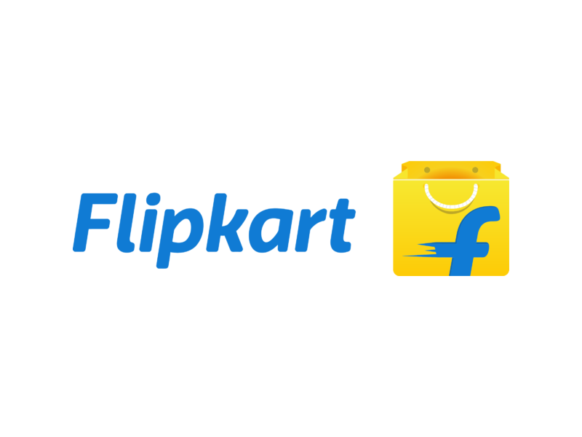
MYNTRA COMPETITORS
Flipkart:As Myntra's parent company, Flipkart is a major competitor in the e-commerce space.
Amazon: A global e-commerce giant that also operates in India and offers a wide range of fashion products.
Ajio: An online fashion retailer offering a variety of products for men, women, and kids.
Nykaa: Known for its fashion and lifestyle products, Nykaa is a significant competitor.
.

Slide 13
COMPETITIVE ANALYSIS
Comparison Factor | Myntra | Amazon India | Flipkart | Ajio | Nykaa
Product Range and Quality | Extensive range of fashion, accessories, beauty products, private labels, international brands | Vast selection across categories, Prime-exclusive products, high-quality standards | Wide variety including electronics, fashion, home essentials, strong quality control | Affordable fashion, ethnic wear, designer collaborations, moderate quality | Leading in beauty and wellness, growing fashion segment, premium brands
Customer Service Rating | Good, with efficient customer support and easy return policies | Excellent, with 24/7 support, high customer satisfaction | Good, with interactive app features and responsive support | Average, with some customer service issues reported | Excellent, strong customer loyalty and support
Social Media Presence and Engagement | Strong presence, frequent updates, influencer collaborations | Very strong, extensive use of social media, high engagement | Strong, regular updates, interactive campaigns | Moderate, growing presence, engagement through social media | Strong, high engagement through beauty content and influencer partnerships
Competitive Advantage | Strong brand recognition, exclusive collections, robust logistics | Global reach, advanced technology, Prime membership benefits | Extensive product range, strong logistics network, Big Billion Days sale | Affordable pricing, exclusive fashion lines, social media marketing | Leading in beauty and wellness, omni-channel presence, high brand loyalty

Slide 14



STRATEGIC
RECOMANDATION
Customer Engagement
Product Development
Enhance Customer service, responsiveness and Logistics
Expand Digital Marketing with Influencer Collaboration
Customer Loyalty Program
Eco Friendly Product
Content Marketing

Slide 15

SWOT ANALYSIS
Strengths
Strong Brand Recognition: Myntra is one of India's most recognized online fashion retail brand.
Diverse Product Portfolio: Offers a wide range of fashion products, including apparel, footwear, accessories, and beauty products
Weaknesses
Intense Competition: Faces stiff competition from other e-commerce platforms,
including its parent company Flipkart.
Dependency on Discounts: Reliance on heavy discounts and promotional offers
to drive sales.
Opportunities
Expansion into Global Markets: Potential to expand its market presence
beyond India.
Private Labels: Selling private label products can increase profit margins
Threats
Economic Fluctuations: Changes in economic conditions can impact consumer spending.
Government Policies: Unfavorable government policies related to e-commerce can pose challenges.

Slide 16


Websites Used For Analysis
Finding Detailed Rankings and competitors and web traffic using this websites:
https://www.semrush.com/website/myntra.com/overview/
For Detailed Competitor Analysis:
https://www.similarweb.com/website/myntra.com/#overview
Myntra competitor analysis:
https://www.semrush.com/website/myntra.com/competitors/

Slide 17
CONCLUSION
In conclusion, Myntra stands as a prominent player in the Indian online fashion and lifestyle market, boasting strong brand recognition, a diverse product portfolio, and advanced technological integration. The company's ability to leverage data analytics and AI, combined with strategic initiatives such as expanding its product range, enhancing customer experience, and strengthening digital marketing efforts, positions it well for continued growth and market leadership.

